Slide 1

IPL DATASET ANALYSIS (2008-2024)
PRESENTED BY:
VIJAYAKUMAR R VIGNESH S VIMAL S VISHALKUMAR S

Slide 2
IPL DATA ANALYSIS
1.Introduction
2.Literature survey
3.Scope and Motivation
4.Details of dataset
5.Tools and Technology
6.Visualisation
7.Conclusion
8.Future Work
9.Reference
OUTLOOK

Slide 3
IPL DATA ANALYSIS
The idea is to analyze the IPL data hosted by Kaggle to come up with something interesting and useful.
The insights from the dataset can really be helpful for the IPL management and team coach to improve themselves.
Handling all the factors like effect of homeground and toss winner is the real world problem.
As the IPL happens every year and is very popular in India therefore analysis
and finding insights can be very useful.
INTRODUCTION

Slide 4
IPL DATA ANALYSIS
The paper "Prediction of IPL Match Outcome Using Machine Learning Techniques" explores predicting IPL match outcomes using machine learning algorithms like Random Forest, SVM, Logistic Regression, and KNN. Using datasets from Kaggle, it analyzes factors such as player performance, venue, toss decisions, and home/away records.
LITERATURE
SURVEY

Slide 5
IPL DATA ANALYSIS
Key findings:
Random Forest achieved the highest accuracy (88.10%).
Toss decisions and venue significantly impact outcomes.
The study emphasizes the potential of machine learning in sports analytics and suggests future work to evaluate individual player performance and predict awards like "Player of the Match."
LITERATURE
SURVEY

Slide 6
IPL DATA ANALYSIS
Predicting the winner of the next season of IPL based on past data can give us idea that which team has higher probability of winning the match which seems pretty interesting.
As the dataset tell about the team, who won the toss along with the information of venue and man of match.
The chances of winning the match by that team can also be determined on basis of these factor which is beneficial for sponsors and advertisement also.
SCOPE AND MOTIVATION

Slide 7
IPL DATA ANALYSIS
The dataset was taken from the kaggle and it contains the latest data of IPL 2019.
The dataset has nearly 756 rows and 18 columns with some missing data and wrong data.
Sorting of data was done at beginning.
The column called Umpire3 in dataset was removed because more than 90% of data was missing
DETAILS OF DATASET

Slide 8
IPL DATA ANALYSIS
Pandas :- Used to import the dataset in various format like csv ,excel etc. and also for the manipulation of data.
Numpy :-Used to do numerical analysis like finding mean, standard deviation and also in linear algebra.
Matplotlib :- It is used for visualization of data in meaningful graphs and charts.
TOOLS AND TECHNOLOGY

Slide 9
IPL DATA ANALYSIS
Seaborn:- Is used for making the visualization & high level interface for creating graphs.
Scipy :- Used for finding z-score values and in finding the confidence level of sample taken randomly from dataset .
Math :- It provides access to some common math functions.
TOOLS AND TECHNOLOGY

Slide 10
IPL DATA ANALYSIS
Exploratory Data Analysis (EDA):
Descriptive Statistics
To summarize the dataset's key characteristics, such as mean, median, mode, standard deviation, and quartiles.
Data Visualization:
To visually represent data and identify patterns or trends.
TOOLS AND TECHNOLOGY

Slide 11
IPL DATA ANALYSIS
Regression:
Linear Regression : To predict numerical values
Classification:
Decision Trees: To classify data into categories
Random Forest: combines multiple decision trees
Clustering:
K-Means Clustering: To group similar data points together,
TOOLS AND TECHNOLOGY

Slide 12
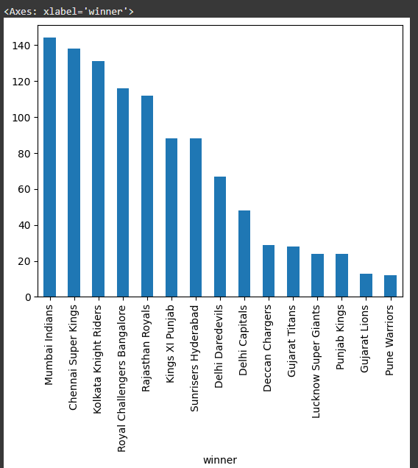
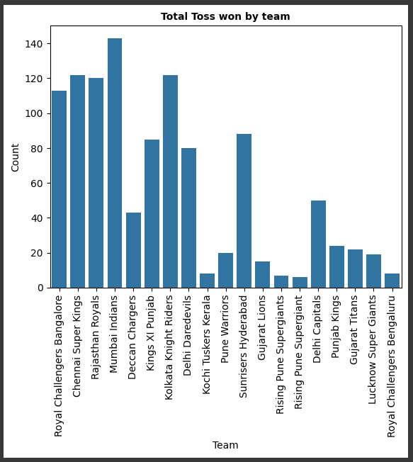
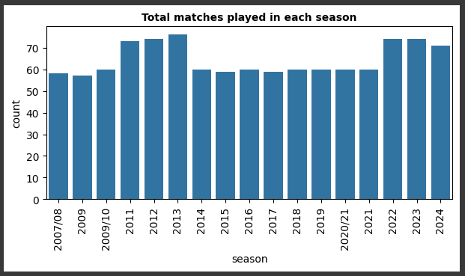
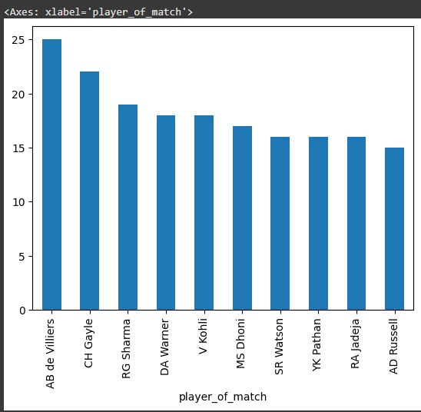
IPL DATA ANALYSIS
VISUALIZATION

Slide 13
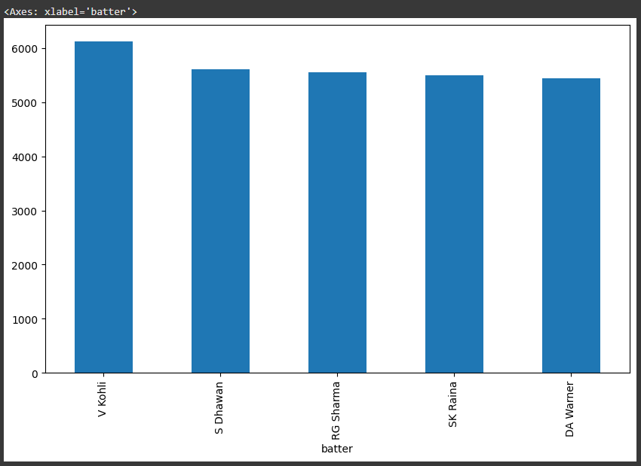
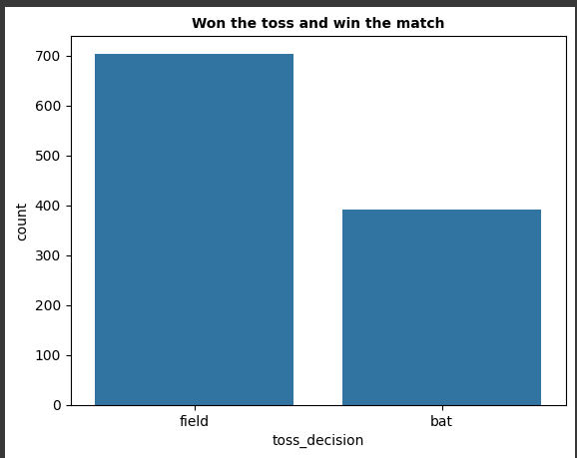
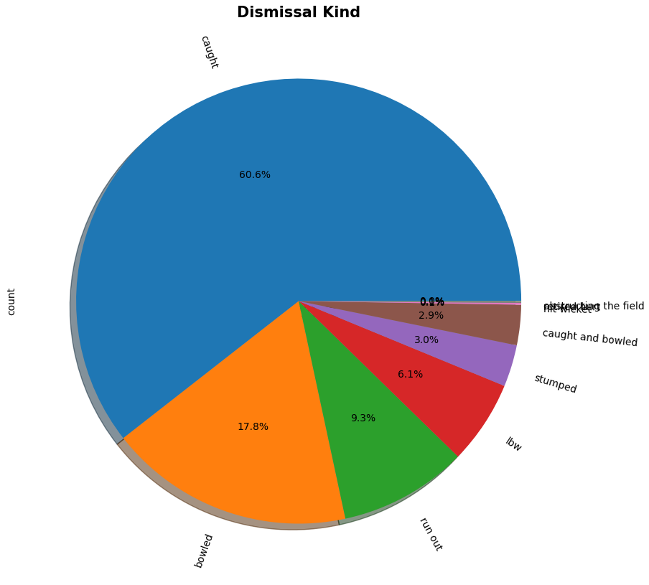
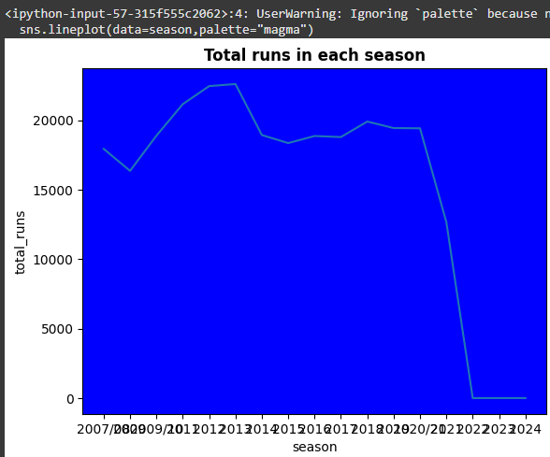
IPL DATA ANALYSIS
VISUALIZATION

Slide 14
IPL DATA ANALYSIS
From the analysis, it was concluded that Chennai Super Kings and Mumbai Indians are more likely to win upcoming IPL seasons.
Kolkata, Bangalore and Delhi is more likely to have bad weather during the IPL season.
Teams have won more matches in their home grounds.
M Chinnaswamy stadium and Eden Gardens is best Suited for Feilding and MA Chidambaram Stadium,Chepauk is best suited for Batting..
CONCLUSION

Slide 15
IPL DATA ANALYSIS
At Mumbai highest number of matches has been played.
Chris Gayle has most title for man of the matches i.e 21.
Delhi Capitals has more chances of winning the toss followed by Deccan Chargers but Delhi Capitals has played only two seasons.
There is no linear relation between win_by_runs and win_by_wicket as correlation coefficient is negative.
CONCLUSION

Slide 16
IPL DATA ANALYSIS
Creating an interactive dashboard and visualizations involves combining your data science results with tools designed for interactivity and user engagement.
1. Select a Framework or Tool
Dash (by Plotly): Ideal for data-driven dashboards.
2. Setting Up the Environment
Installing Dash
FUTURE WORK

Slide 17
IPL DATA ANALYSIS
3. Preparing Your Data
Cleaning,Integrating,Transforming
4.Designing the Layout
Dash uses Python for layout and callback functionality
5. Adding Interactivity
Filters,Dynamic visualization
FUTURE WORK

Slide 18
IPL DATA ANALYSIS
6. Enhancing Visual Appeal
Use Plotly for interactive charts
Integrate Bootstrap (in Dash) for responsive design
7. Deployment
Locally run by app.run_server()
FUTURE WORK

Slide 19
IPL DATA ANALYSIS
1. https://github.com/Rajdeep2121/IPL-Analysis
2.https://www.linkedin.com/posts/riya-sharma-a83532244_ipl-data-analysis-in-sql-ppt-activity-7242474732116189184-gPJd
3.https://www.kaggle.com/datasets/patrickb1912/ipl-complete-dataset-20082020
4.https://www.youtube.com/watch?v=iK_8VPoh3ds
5.https://github.com/subhamyadav580/Data-Analysis-with-IPL-Dataset/blob/main/IPL.ipynb
REFERENCE

Slide 20
THANK YOU

